Slide 1

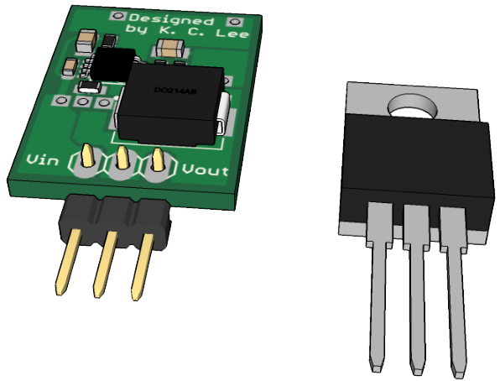
SMPS replacement for 7805
This is a collection of switch mode power supply modules designs that are efficient drop-in replacement for the old 78XX series.

Slide 2
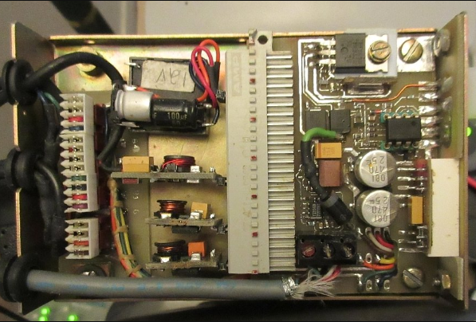
Current Status
I am using these modules in my “Emergency Backup Power and Wallwarts Eliminator” project and they have been working 24/7 for the last 7-8 years on some of them.
12V Buck
KIS-3R33S
Isolated
12V Buck
5V Buck

